Slide 1
Potential of Strategic Marketing for Financial Services
Capstone
Batch : P04_Class A_AWS
Group 4
Pavan Kumar Bandaru
Nishanth Sridhar
Juhi Bhattacharya
Sai Siddarth Akula
Deepa Raj
Jayavanth R
September-November 2024

Slide 2
Table of Contents
Problem Statement
E-R Diagram
Data Manipulation Using Python
SQL-Oracle
Visualization using Power BI
Data Analysis Using Big Data Tools
Data Analysis + ML Model Training and Deployment on Cloud​
Conclusion

Slide 3
Problem Statement
HBCF Bank recently conducted a direct phone call campaign to promote its term-deposit scheme, collecting extensive data on customer demographics, social, and economic factors. The campaign's success was measured by whether customers accepted ('yes') or declined ('no') the offer.
The bank seeks to analyze this data to understand the effectiveness of its marketing strategies and identify key factors influencing customer decisions.
The objective is to use these insights to refine future campaigns, enhance targeting, and improve overall campaign success rates.

Slide 4
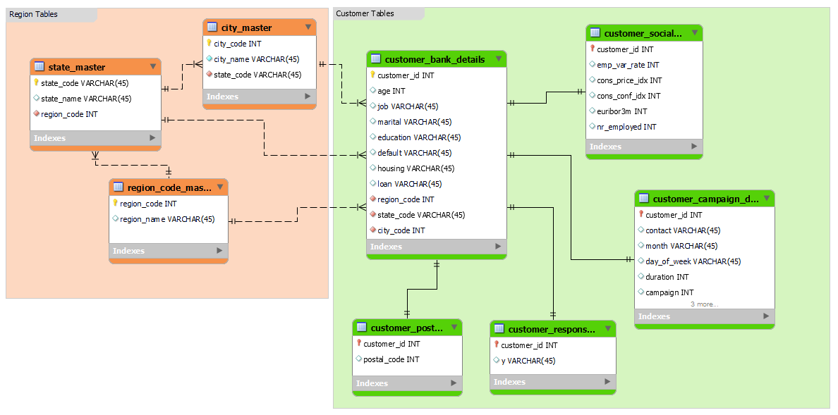
E-R Diagram

Slide 5
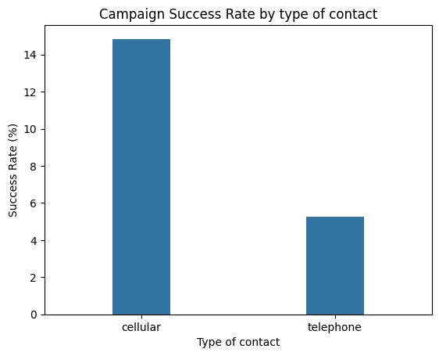
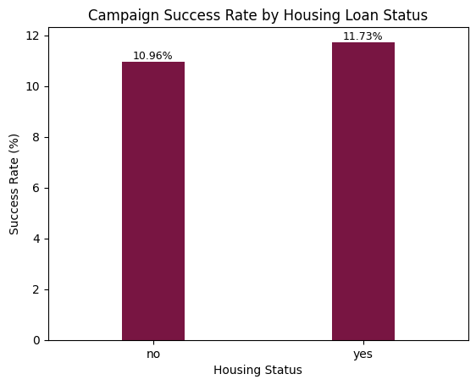
Data Manipulation Using Python
INSIGHTS:​​
Data shows the correct mode to contact the customers​
It is observed that we get more yes responses when the mode is cellular​
INSIGHTS:
It is observed that customers who HAVE a housing loan are most likely to respond YES to the campaign

Slide 6
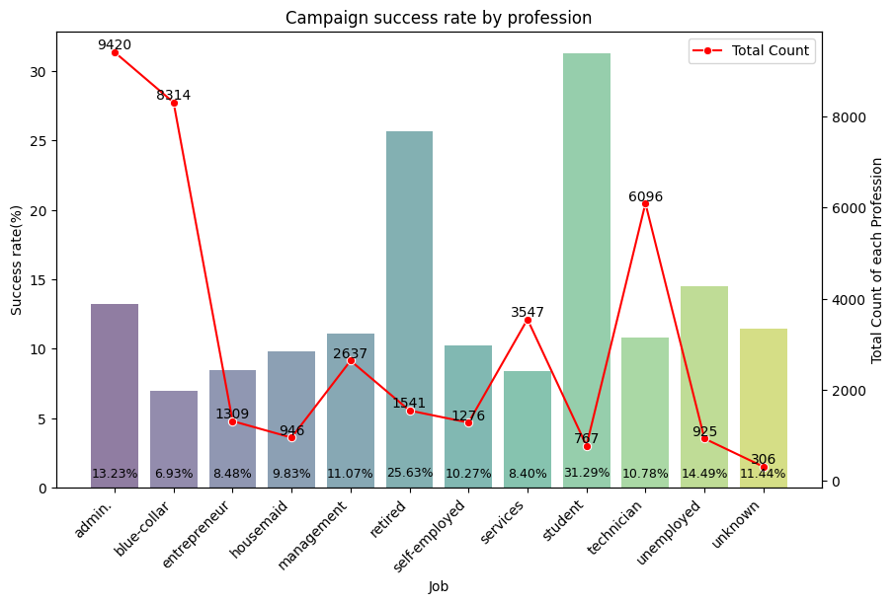
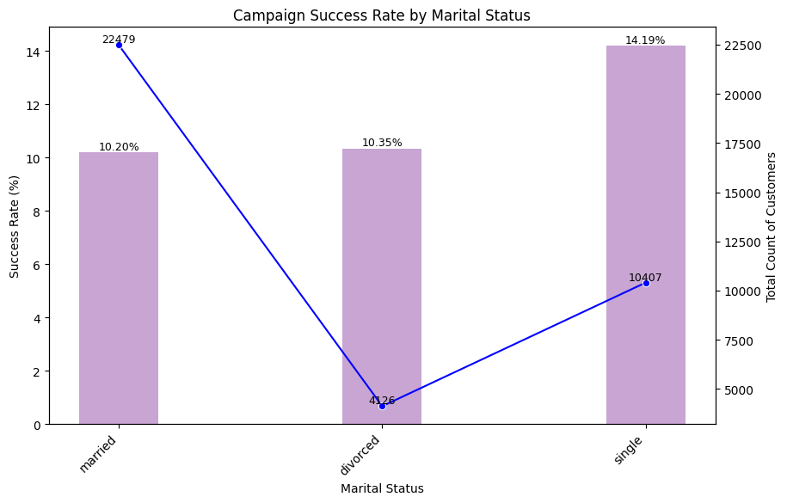
INSIGHTS:
Data shows the success rate by profession.
Students make the campaign more successful followed by the retired customers.
INSIGHTS:
Data shows the success rate of the campaign based on marital status of customers
It is observed that customers who are not married yet are most likely to respond yes

Slide 7
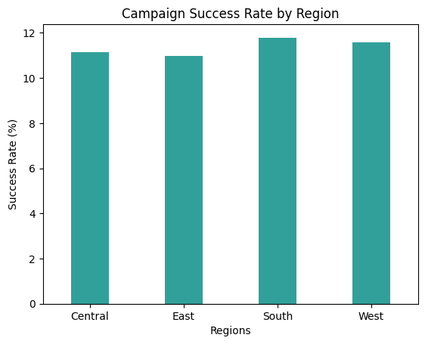
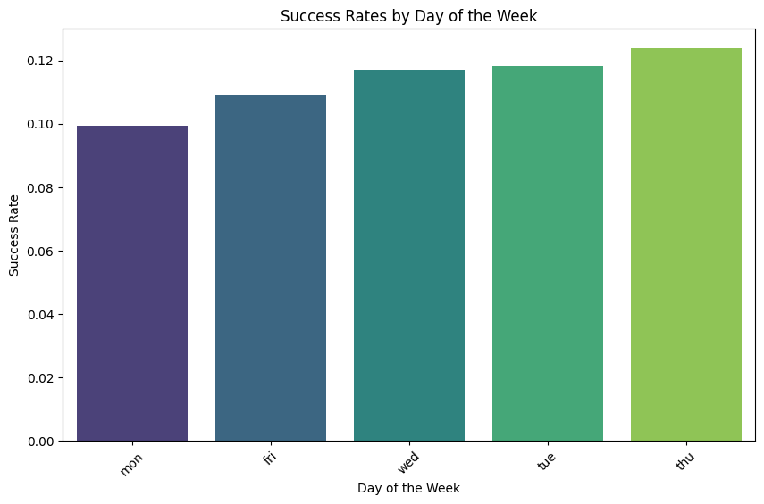
INSIGHTS:
Data shows the success rate by region.
All regions have similar success rates, but the South region achieved the highest success rate.
INSIGHTS:
Data shows the success rate of the campaign based on the day of the week in which the contact is made to customers.
It is observed that the response YES is highly likely when the contact is made on a Thursday.

Slide 8
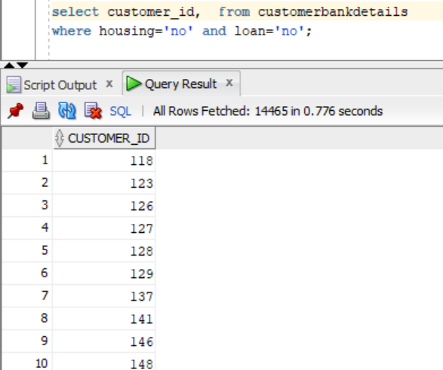
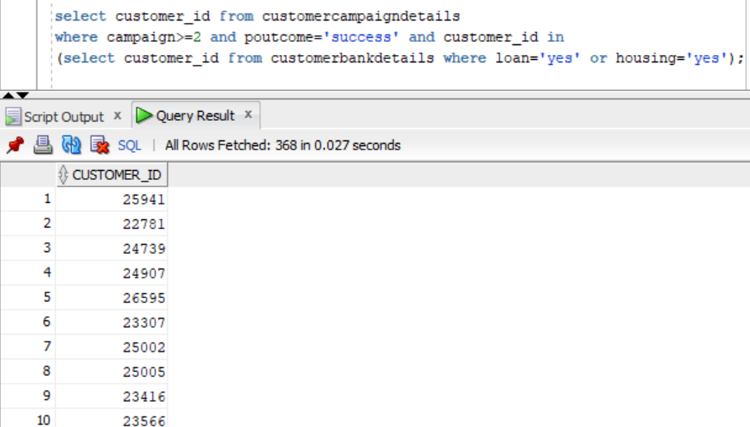
SQL-Oracle
Data shows the list of customers with NO housing and personal loans
Data shows the number of customers who have both housing and personal loan and were contacted more than 2 times
and responded with YES​

Slide 9
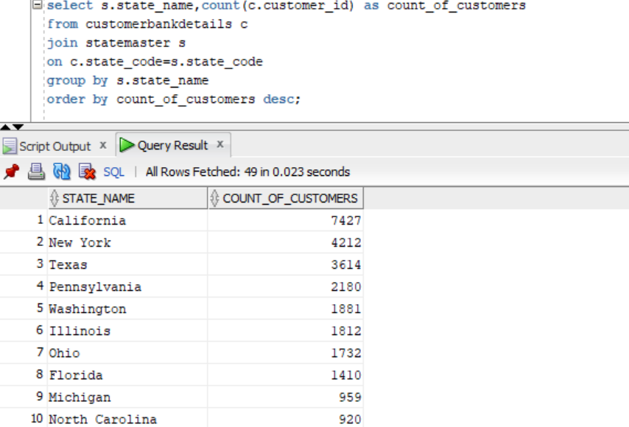
Data shows the state-wise breakup of the number of customers sorted by number of customers in each state

Slide 10
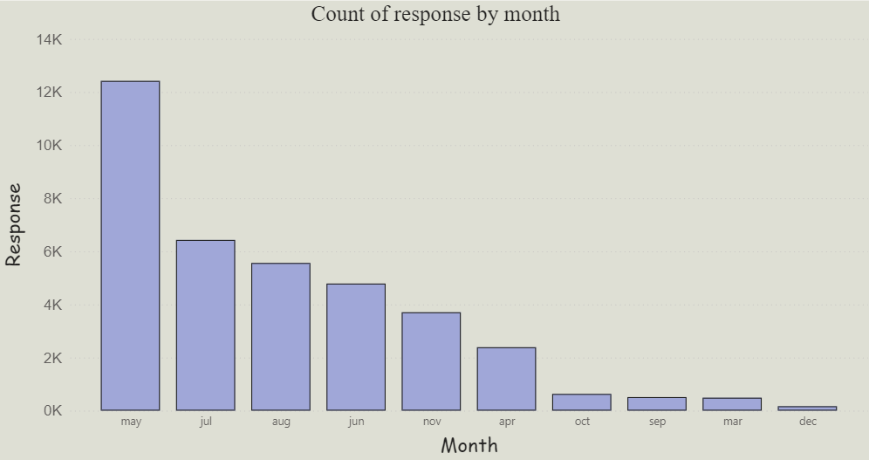
Visualization using Power BI
INSIGHTS:
Data shows monthly response analysis throughout the year for the campaign.
From the chart we can infer that Responses peak in May and are lowest in December.

Slide 11
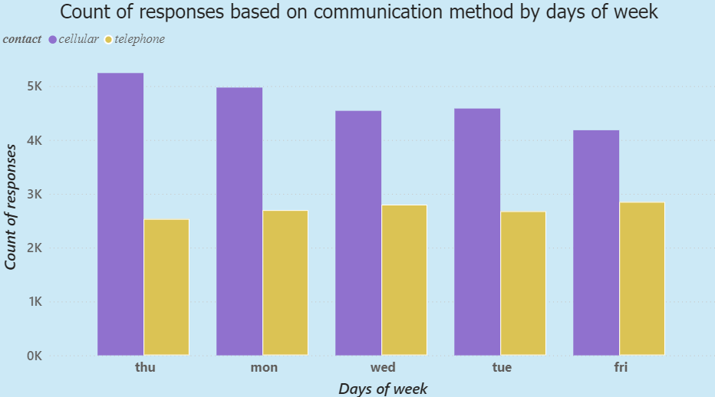
INSIGHTS:
Data shows right mode to contact the customers on all the days of the week which is cellular
There is no day of the week where customers responded to telephonic call than to cellular calls

Slide 12
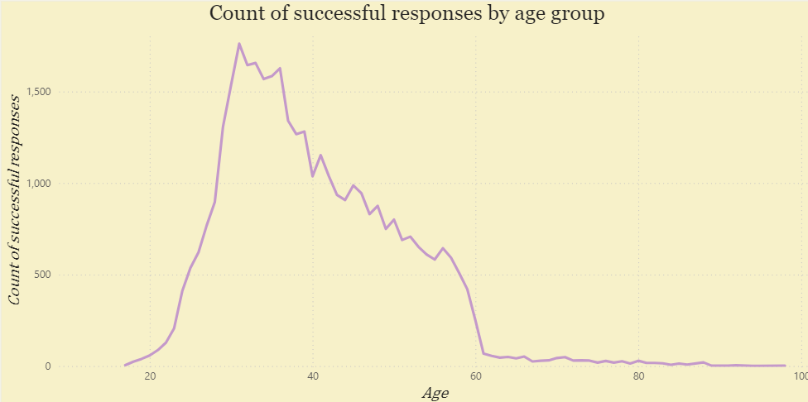
INSIGHTS:
Data shows successful responses by age group
People aged 25-40 have the highest response success rate

Slide 13
Data Analysis + ML Model Training and Deployment on Cloud​
S3
◘ Move the datasets to S3 bucket
Redshift
◘ Create a Redshift cluster
◘ Create a bucket in AWS S3
◘ Create required database and tables
◘ Move the storage from S3 storage to warehouse
PowerBI
◘ Connect to Redshift using redshift endpoint address and database name
◘ Get data from Redshift
1. Redshift to Power BI Connectivity​

Slide 14
2. Add records to S3 for any new items added in the DynamoDB​
Create a table in DynamoDB
Create a Lambda function
Add a trigger to monitor DynamoDB
As soon as items get added in DynamoDB, Records are written into S3 bucket
Create a S3 bucket
Validate the output in S3

Slide 15
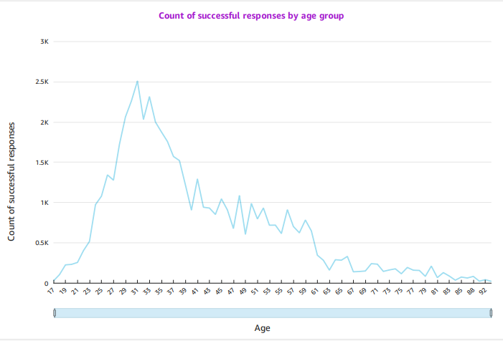
3. Transfer the AWS s3 data to AWS Quick sight perform the same analysis done using PowerBI
INSIGHT:​
Data shows successful responses by age group
People aged 25-40 have the highest response success rate

Slide 16
4. 50% of CPU of EC2 exceeds then cloud watch must trigger the alarm.​
EC2
Create an EC2 instance
Cloudwatch
Create an alarm for CPU Utilization greater than 50
Result
As the EC2 CPU utilization goes above threshold, we get alarm as a mail
EC2 instance gets terminated

Slide 17
S3
Adding a trigger to monitor S3 bucket
Code written to extract the file name and size is deployed
Cloudwatch
As a file gets uploaded into S3 bucket, Lambda function is triggered
Lambda
Creating a function
Create a bucket
Create a folder named input
Required file name and size are displayed in logs
5. Creating a Lambda function which logs in cloud trail about S3 file type and size​

Slide 18
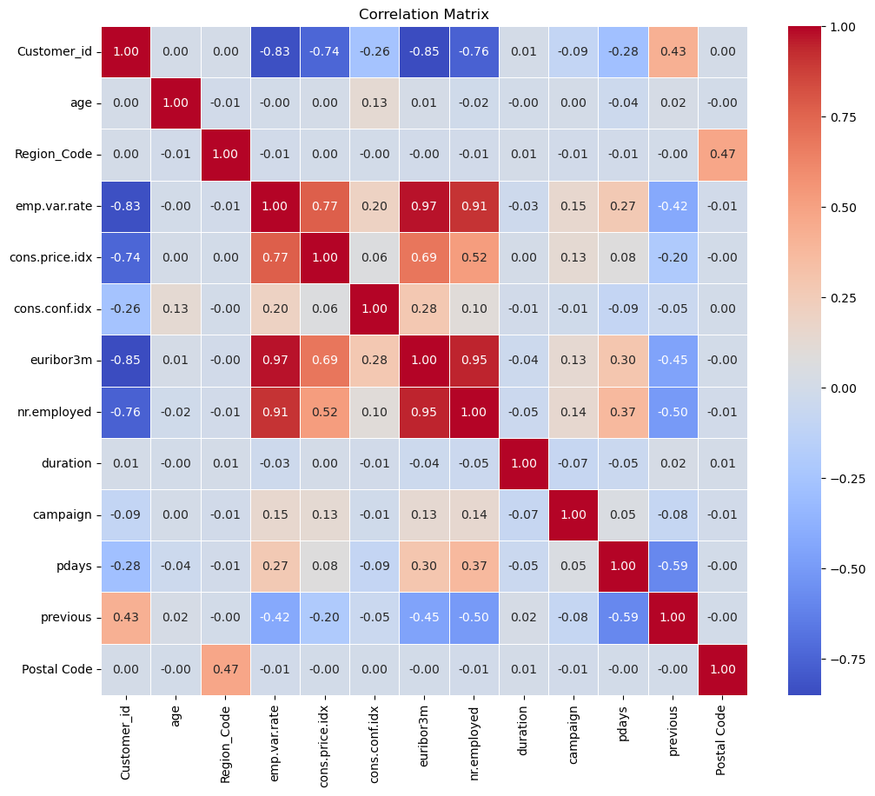
6. Build appropriate ML model/s on the data using AWS Sage maker, Identify the right metric to evaluate the performance of the model and deploy on AWS Sagemaker
PREPROCESSING
Merging all tables to make a common dataset
Performing One-Hot and Label encoding on the categorical data
Perform Random Under-Sampling and SMOTE for Unbalanced Data
Dropping columns with high correlation
With Over-sampling, used auto-encoders for dimensionality reduction

Slide 19
 | LOGISTIC REGRESSION | SVM | XGBOOST | RANDOM FOREST
F1 SCORE | 0.8252 | 0.8453 | 0.8252 | 0.8644
PRECISION | 0.8337 | 0.8349 | 0.8387 | 0.8325
RECALL | 0.8168 | 0.8438 | 0.8148 | 0.8989
ACCURACY | 0.8272 | 0.8361 | 0.8271 | 0.8592
Auto-Encoder with architecture :
Encoder (Input,128,64,32)
Bottleneck (16)
Decoder(32,64,128,Input)
Reduced features used as input for all the models
 | LOGISTIC REGRESSION | SVM | XGBOOST | RANDOM FOREST
F1 SCORE | 0.7471 | 0.8453 | 0.7471 | 0.8891
PRECISION | 0.7296 | 0.8349 | 0.7296 | 0.8869
RECALL | 0.7654 | 0.8438 | 0.7654 | 0.8913
ACCURACY | 0.7406 | 0.8361 | 0.8262 | 0.8887
Models ran on Randomly Under-sampled Data
Models ran on randomly over-sampled Data using SMOTE

Slide 20
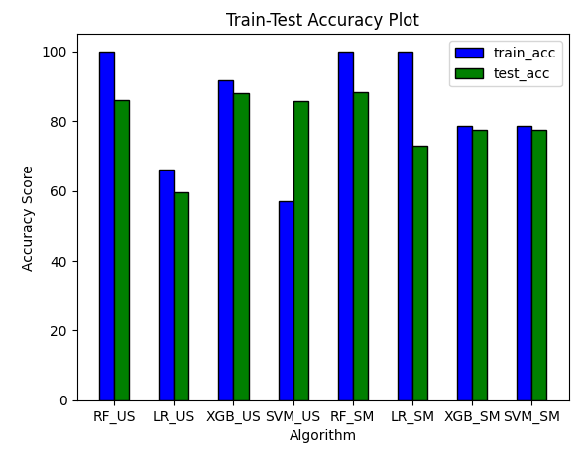
Comparision of all models
Random Forest using SMOTE and Dimensionality reduction gives best
testing and training accuracy
(88.98 and 98.41 respectively)

Slide 21
Conclusion:
W
WHAT MADE THE CAMPAIGN SUCCESSFUL?
Customers who had mobile phones gave more positive responses.
Customers who has housing loan made the campaign successful.
Customers in South region made the campaign more successful.
Customers who were contacted during May gave more positive responses when compared to other months of the year
Customers who were contacted on Thursdays gave more positive responses.
AREAS TO IMPROVE:
We can reduce contacting customers who have telephones
More percentage of students responded positively but number of students targeted should be increased to get more success.
Blue collar professionals did not yield a positive response. So, we should shift the target from them.
Avoid contacting people on Mondays
Avoid contacting people during holiday months i.e. December

Slide 22
Thank You

